Slide 1
Introduction to OSG
Tim Cartwright
OSG User School Director & OSG Special Projects Manager
University of Wisconsin–Madison

Slide 2
Overview
So far, we have seen how to use HTC on one cluster
Sometimes, that is not enough!
(Don’t let computing hold back your science, remember?)
Today, we see what it takes to get more resources *
* Caveat: I will focus on compute resources; Friday will focus on data.

Slide 3
Accessing compute resources

Slide 4
Free Resources – In Your Lab
Server or cluster in your lab
Not your laptop, control everything
Buy and maintain it, not a lot of resources
https://images.abmx.com/30/3004/abmx_3004_1_1200.jpg

Slide 5
Free Resources – Local Cluster
Department or campus cluster
No/low direct costs, local help
Shared; maybe Slurm, PBS/Torque, LSF…
No campus cluster? Talk to CIO!
Note! NSF CC* Compute awards
https://www.nsf.gov/pubs/2021/nsf21528/nsf21528.htm
https://www.pngall.com/wp-content/uploads/5/Server-Rack-PNG-Free-Image.png

Slide 6
Free Resources – Collaborators
Collaborators
No/low direct costs, may be tailored to project
Shared, project-specific, hard to come by
https://www.dunescience.org/about-the-collaboration/

Slide 7
Free Resources – Science Gateways
Science Gateways (e.g., web front-end to a cluster)
Easy to use, no/low cost
Only for pre-defined use cases

Slide 8
Commercial Resources
Commercial clouds (Amazon, Google, Microsoft, …)
Don’t own, high availability, many options (e.g., GPUs), …
Pay/hour, data out may be costly; challenging to manage
Managed clouds (Azure CycleCloud, Globus Genomics, …)
As above, but less to manage
Costs more (paying someone to manage), fewer options?
But keep commercial options in mind:
Credits may be available
May be able to write into grants
May be helpful for burst of activity (e.g., for a deadline)

Slide 9
What Do We Want?
Lots of resources – available, stretchy, & reliable
Submit locally, run globally (as close as possible)
Automation to get resources, manage them, and run jobs
Free would be nice! (Who pays?)

Slide 10
OSG: Distributed HTC

Slide 11
A dHTC Challenge
What would you do with logins to 10 clusters?
5 sites run HTCondor, 3 Slurm, 1 PBS, 1 LSF
1 site focuses on special hardware (GPUs)
2 sites have some servers with lots of memory
All Linux… 3 RHEL, 4 CentOS, 2 Rocky, and 1 Ubuntu
1 site only takes biology-related jobs
4 sites limit job duration, but different limits on each
You want to run 2,000 jobs … go!

Slide 12
Manual dHTC
One could imagine this process:
Log in to System #1, check availability, submit 200
Log in to System #2, check availability, submit 150
Log in to System #3, check availability, submit 400
Log in to System #4, oh wait, it’s down today
Log in to System #5, check availability, submit 350
…
Which jobs are left to submit? Which are running? Help!

Slide 13
Automation?
Automation can help, but…
https://xkcd.com/1319/

Slide 14
Fundamental Flaws
There are fundamental flaws to this approach:
Commits jobs to clusters before getting resources!
Uses only a snapshot of availability
Things could turn out very differently than planned
Other users get resources first (and run for days)
Your jobs don’t actually match resources
Your jobs start, but fail every time

Slide 15
A Better Approach to dHTC
Get resources first (due to demand or being idle)
Consolidate resources into a pool
Provide users with an Access Point into the pool (not quite submit locally, but at least just 1 place)
Automate management of resources and jobs
Sounds easy, right? 😉

Slide 16
OSG dHTC Diagram
Step 1: Before OSG
Nothing available at Wisc. 😭
Wisconsin
Busy
Busy
Busy
Busy
Busy
Syracuse
Busy
Busy
Busy
Busy
Busy
Busy
Busy
Nebraska
Busy
Busy
Queue
Job1.0
Job1.1
Job1.2
Job1.3
…
Job1.1999
Chicago
Busy
Busy
Busy
San Diego
Busy
Busy

Slide 17
OSG dHTC Diagram
Step 2: Run OSG Pilots
Getting resources!
Wisconsin
Busy
Busy
Busy
Busy
Busy
Syracuse
Busy
OSG Pilot SU1
Busy
Busy
Busy
OSG Pilot SU4
OSG Pilot SU2
OSG Pilot SU3
Busy
Busy
Busy
Nebraska
OSG Pilot NU1
OSG Pilot NU2
Busy
Busy
Queue
Job1.0
Job1.1
Job1.2
Job1.3
…
Job1.1999
Chicago
OSG Pilot UC2
OSG Pilot UC1
Busy
Busy
Busy
San Diego
OSG Pilot SD2
Busy
OSG Pilot SD1
OSG Pilot SD3
Busy

Slide 18
OSG dHTC Diagram
Step 3: OSG Pilots
Add resources to Pool
Wisconsin
Busy
Busy
Busy
Busy
Busy
Syracuse
Busy
OSG Pilot SU1
Busy
Busy
Busy
OSG Pilot SU4
OSG Pilot SU2
OSG Pilot SU3
Busy
Busy
Busy
Nebraska
OSG Pilot NU1
OSG Pilot NU2
Busy
Busy
Queue
Job1.0
Job1.1
Job1.2
Job1.3
…
Job1.1999
Pool
OSG Pilot NU1 | idle
OSG Pilot NU2 | idle
OSG Pilot SD1 | idle
OSG Pilot SD2 | idle
OSG Pilot SD3 | idle
OSG Pilot UC1 | idle
OSG Pilot UC2 | idle
OSG Pilot SU1 | idle
OSG Pilot SU2 | idle
OSG Pilot SU3 | idle
OSG Pilot SU4 | idle
Chicago
OSG Pilot UC2
OSG Pilot UC1
Busy
Busy
Busy
San Diego
OSG Pilot SD2
Busy
OSG Pilot SD1
OSG Pilot SD3
Busy

Slide 19
OSG dHTC Diagram
Step 4: Run jobs
HTCondor with Queue & Pool
Wisconsin
Busy
Busy
Busy
Busy
Busy
Syracuse
Busy
SU1 > Job1.8
Busy
Busy
Busy
SU4 > idle
SU2 > Job1.12
SU3 > Job1.10
Busy
Busy
Busy
Nebraska
NU1 > Job1.4
NU2 > idle
Busy
Busy
Queue
Job1.0
Job1.1
Job1.2
Job1.3
…
Job1.1999
Pool
OSG Pilot NU1 | Job1.4
OSG Pilot NU2 | idle
OSG Pilot SD1 | Job1.0
OSG Pilot SD2 | Job1.3
OSG Pilot SD3 | idle
OSG Pilot UC1 | Job1.2
OSG Pilot UC2 | Job1.6
OSG Pilot SU1 | Job1.8
OSG Pilot SU2 | Job1.12
OSG Pilot SU3 | Job1.10
OSG Pilot SU4 | idle
Chicago
UC2 > Job1.6
UC1 > Job1.2
Busy
Busy
Busy
San Diego
SD2 > Job1.3
Busy
SD1 > Job1.0
SD3 > idle
Busy

Slide 20
OSG dHTC Diagram
Getting other resources
E.g., SU starts Pilots when idle
Wisconsin
Busy
Busy
Busy
Busy
Busy
Syracuse
Busy
SU1 > Job1.8
Busy
Busy
Busy
SU4 > idle
SU2 > Job1.12
SU3 > Job1.10
Busy
SU Pilot OG1
Busy
Busy
Nebraska
NU1 > Job1.4
NU2 > idle
Busy
Busy
Queue
Job1.0
Job1.1
Job1.2
Job1.3
…
Job1.1999
Pool
OSG Pilot NU1 | Job1.4
OSG Pilot NU2 | idle
OSG Pilot SD1 | Job1.0
OSG Pilot SD2 | Job1.3
OSG Pilot SD3 | idle
OSG Pilot UC1 | Job1.2
OSG Pilot UC2 | Job1.6
OSG Pilot SU1 | Job1.8
OSG Pilot SU2 | Job1.12
OSG Pilot SU3 | Job1.10
OSG Pilot SU4 | idle
SU Pilot OG1 | idle
Chicago
UC2 > Job1.6
UC1 > Job1.2
Busy
Busy
Busy
San Diego
SD2 > Job1.3
Busy
SD1 > Job1.0
SD3 > idle
Busy

Slide 21
OSG dHTC – A Few Details
OSG pilots get resources
OSG Factory submits pilots to clusters at known sites; some will run
Site starts pilots itself when cluster resources are idle
Similar processes for XD (HPC) and Cloud resources
A pilot runs part of HTCondor itself
A pilot leases the resources it is given for a while
Can expire after time, when idle, or when kicked out
A pilot doesn’t really use resources, just holds on to them, and reports them to a central service, adding to a pool
An Access Point is a place to submit jobs to a pool
OSG and HTCondor manage/automate the details!
Note: Terms in italics are jargon. You may hear these terms, but it is not critical to memorize them.

Slide 22
Open Science Pool
Open Science Pool (OS Pool) for all of Open Science
It has many Access Points (e.g., projects, campuses)
OSG Connect is an Access Point for US projects (incl. collaborators)
Other pools exist for specific groups
Collaborations (e.g., gravitational-wave projects)
Projects (e.g., DUNE neutrino physics project)
Campuses (e.g., HCC at University of Nebraska)

Slide 23
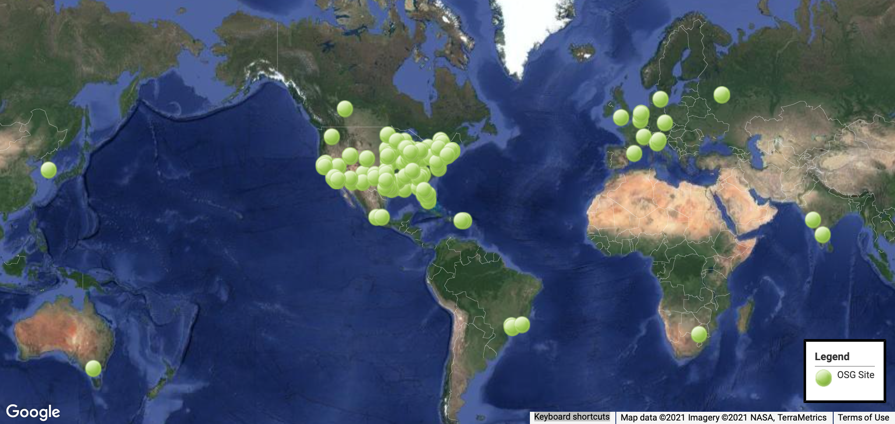
OSG Sites (Many are in Open Science Pool)

Slide 24
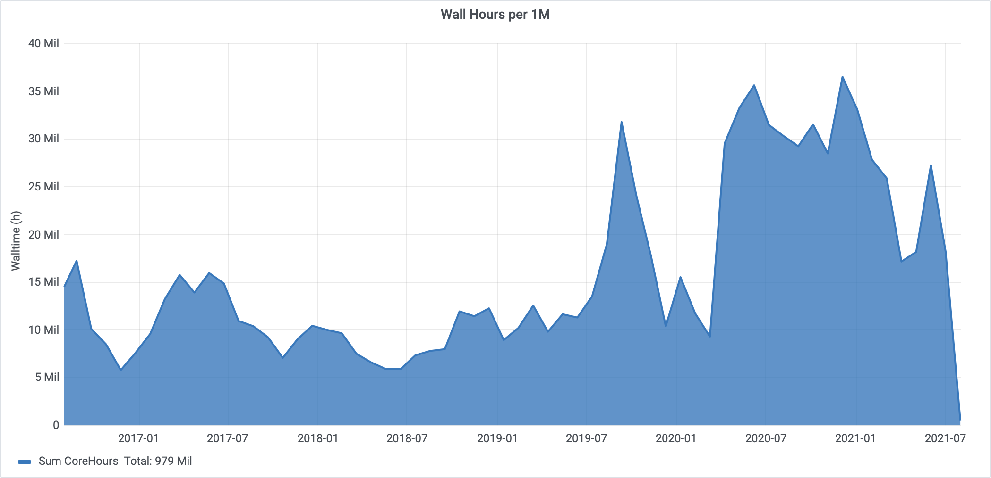
Open Science Pool Usage

Slide 25
Using OSG

Slide 26
OSG Is HTCondor
OSG (e.g., OS Pool) is like a local HTCondor pool:
You have condor_q, condor_submit, DAGMan, etc.
OS Pool bonus features!
More resources (usually) than a typical local system
Some pre-built software packages (SW lecture, Thu.)
Some storage on Access Point (Data lecture, Fri.)
Some special resources, like GPUs (GPU topic, Mon.)

Slide 27
So Why Learn How OSG Works?
More “moving parts” means that there are more ways in which things can go wrong
Greater variation than typical local system:
Varied hardware
Varied operating systems and software
Varied policies
Varying in availability
Not all HTCondor features work or work well in OSG (e.g., condor_ssh_to_job)

Slide 28
Varied Hardware
Request what you need in submit files
CPUs (“cores”): request_cpus
Memory: request_memory
Disk on execute server: request_disk
Some other hardware requirements can be specified; search for documentation or contact us
Often in submit-file requirements expression
Example: GPU needs (GPU topic, Mon.)

Slide 29
Varied OSs and Software
Varied operating systems
All Linux, mostly recent, but lots of variation
Software on Access Point may not exist on execute! (e.g., Python 2 versus Python 3)
Your software
Never assume your software is on the execute server
Attend tomorrow’s (Thu.) lecture on this topic!

Slide 30
Varied Policies
Individual sites/clusters have their own policies
Example: Maximum run-time of a job (or its pilot)
If possible, set requirements for what you need
But this does not help with, e.g., maximum run-time
Generally, try to make “OSG-sized” jobs (see next)

Slide 31
What Makes a Good OSG Job?

Slide 32
More OSG Tips – Testing
Test early, test often
Specify output, error, and log files
If possible, add strategic logging to software (but don’t fill disk with logs!)

Slide 33
More OSG Tips – Scaling Up
1 job
Did it work?
Check and adjust resource usage!
10 jobs
Check everything again
Check and adjust resource usage again
Maybe another intermediate stage
At each scale: Fix issue and repeat until solid

Slide 34
More OSG Tips – Access Point
Access Points are shared resources
No long-running and resource-intensive processes
Do those things in jobs instead
Estimate AP resource needs for whole run(s)
Especially input and output data (Data lecture, Fri.)
Also: directories, logs, file transfers, etc.

Slide 35
More OSG Tips – Security
Computer security is hard — read the headlines!
OSG does its best, but no system is perfect
Some suggestions:
Use strong, distinct passwords for each account
Do not share your account
Avoid world-writable directories and files
Avoid sensitive software and data (no HIPAA!)
Do not try to work around security barriers; contact us to help meet your goals in a safe way

Slide 36
Troubleshooting

Slide 37
General Troubleshooting Tips
Comparing expectations vs. what happened: Either might be wrong!
Read messages carefully — even if some parts make no sense, what hints can you get?
Search online … but evaluate what you find
Collect links and other resources that help
Ask for help! And provide key details: versions, commands, files, messages, logs, etc.

Slide 38
Issue: Failed to Parse
$ condor_submit job.sh
Submitting job(s)
ERROR: on Line 6 of submit file:
ERROR: Failed to parse command file (line 6).
Completely failed to submit!
Notice: Failed to parse
Why: You tried to submit your executable (or other file), not an HTCondor submit file
Fix: Submit an HTCondor submit file (e.g., .sub)

Slide 39
Issue: Typos in Submit File
$ condor_submit sleep.sub
Submitting job(s)
• ERROR: No 'executable' parameter was provided
• ERROR: Parse error in expression:
RequestMemory = 1BG
• ERROR: Executable file /bin/slep does not exist
Also failed to submit (missing job(s) submitted)
Why: Typos in your submit file (e.g., BG for GB)
Fix: Correct typos!

Slide 40
Issue: Jobs Idle for a Long Time
$ condor_q
OWNER BATCH_NAME SUBMITTED DONE RUN IDLE TOTAL JOB_IDS
cat ID: 123456 6/30 12:34 _ _ 1 1 123456.0
Jobs are idle for a long time – can be hard to judge!
$ condor_q -better-analyze 123456.0
...
Slots
Step Matched Condition
----- -------- ---------
[0] 13033 TARGET.PoolName == "CHTC"
[9] 13656 TARGET.Disk >= RequestDisk
[11] 0 TARGET.Memory >= RequestMemory

Slide 41
Issue: Jobs Go on Hold
$ condor_q
OWNER BATCH_NAME SUBMITTED DONE RUN IDLE HOLD TOTAL JOB_IDS
cat ID: 123456 7/11 11:23 _ _ _ 1 1 123456.0
Jobs are held when HTCondor doesn’t know what to do
$ condor_q -held
...
ID OWNER HELD_SINCE HOLD_REASON
123456.0 cat 7/11 11:24 Error from slot1_16@e122.chtc.wisc.edu: Failed to execute '/var/lib/condor/execute/slot1/dir_19728/condor_exec.exe': (errno=8: 'Exec format error')

Slide 42
Issue: Some Common Hold Reasons
Failed to initialize user log to /path or /dev/null
Could not create log file, check /path carefully
Error from …: Job has gone over memory limit of AAA megabytes. Peak usage: BBB megabytes.
Job used too much memory
Request more – at least BBB megabytes!
Error from …: STARTER at … failed to send file(s) to <…>: error reading from /path: (errno 2) No such file or directory; SHADOW failed to receive file(s) from <…>
Job specified transfer_output_files
But /path on remote server was not found
Jargon: SHADOW is Access Point, STARTER is Execute Point

Slide 43
What To Do About Held Jobs
If the situation can be fixed while job is held (e.g., you forgot to create directory for output):
Fix the situation
Release the job(s): condor_release JOB_IDs
Otherwise (and this is common):
Remove the held jobs: condor_rm JOB_IDs
Fix the problems
Re-submit

Slide 44
Issue: Missing or Unexpected Results
Job runs … but something does not seem right
Short or zero-length output file(s)
Very short runtime (almost instant)
May be problems with app, inputs, arguments, …
Check log files for unexpected exit codes, etc.
Check output and error files for messages from app
Can’t find anything? Add more debugging output

Slide 45
Issue: Badput
What is badput?
Basically, wasted computing
Job runs for 97 minutes, gets kicked off, starts over on another server
Job runs for 97 minutes, is removed
Not jobs that must be re-run due to code changes! (that’s just part of science, right?)
Badput uses resources that others could have used
Tools for self-monitoring are in development
If contacted, help us help you and others!

Slide 46
More Troubleshooting Resources
Brian Lin's OSG User School 2019 talk (TBH: I copied a lot from there!)
OSG Connect documentation
support@opensciencegrid.org

Slide 47
Acknowledgements

Slide 48
You Can Acknowledge OSG!
If you publish or present results that benefitted from using OSG, please acknowledge us!
https://support.opensciencegrid.org/support/solutions/articles/5000640421-acknowledging-the-open-science-grid

Slide 49
Acknowledgements
OSG team, especially Brian Lin, Mats Rynge, and Jason Patton
This work was supported by NSF grants MPS-1148698, OAC-1836650, and OAC-2030508

Slide 50
Demonstrations

